Slide 1


Bilateral High-grade Stenosis of Intracranial Internal Carotid Artery in a Patient with Multiple Myeloma
25th European Society of Neurosonology and Cerebral Hemodynamics (ESNCH) Conference, Belgrade, Serbia, October 15-17, 2021
Jurgita Valaikiene, Kristina Ryliskiene, Liudmila Beliak, Dalius Jatuzis
Vilnius University, Centre of Neurology, Lithuania

Slide 2
Disclosures
The Speaker has no financial interests in any product or device discussed.
The Speaker has no conflict of interests to disclose.
No off label uses of medications or devices will be discussed.

Slide 3
Multiple Myeloma and cerebrovascular complications
Multiple myeloma (MM) is a malignancy of plasma cells, associated with significant morbidity and mortality.
MM remains the second most common hematological malignancy in Europe and the US (approx. 40 000 and 32 000 new cases/year).
A recently cohort study demonstrates an increased risk of a stroke in MM patients with a kappa light chain isotype.
A case of a newly diagnosed lambda light chain multiple myeloma with multiple brain infarcts and vasculopathy, predominantly in the distal ICA.
Siegel et al. CA Cancer J Clin 2020; Cowan et al. JAMA Oncol 2018; SEER*Explorer. An interactive website for SEER cancer statistics. Internet, Surveillance Research Program. National Cancer Institute; 2020; Lee et al. Hematol Oncol 2017

Slide 4
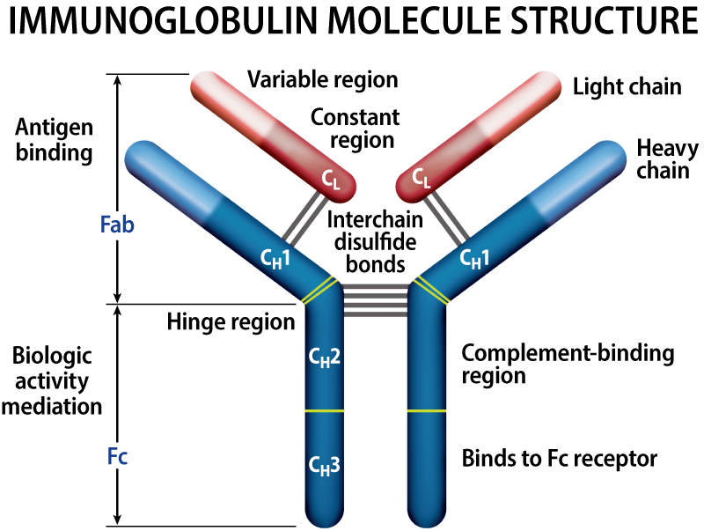
Multiple Myeloma (MM)
Immunoglobulin (Ig) molecule structure
Clinical presentation*:
    Anemia – 73 %
    Bone pain – 58 %
    Elevated creatinine – 48 %
    Fatigue/generalized weakness – 32 %
    Hypercalcemia – 28 %
Diagnostics of MM (mnemonic – CRAB):
Calcium elevation
Renal insufficiency
Anemia
Bone disease
MM has different types and subtypes, based on the Ig (protein) produced by the myeloma cell.
Each Ig is made up of 2 heavy chains and 2 light chains.
Light chains: kappa (κ) and lambda (λ).
Approximately 15% of patients have light chain (LC) or Bence Jones myeloma.
There is a paucity of data on LC MM in the literature.
https://www.myeloma.org/types-of-myeloma
*Kyle et al. Mayo Clin Proc 2003; Ravi et al. Cancer Treat Res Commun 2021; Rafae et al. Cureus 2018

Slide 5
Clinical case
50-year-old female
Initial complaints:
- decreased exercise tolerance,
- pulsatile tinnitus (feeling, that „her head will explode“)
- dyspnea.

Slide 6
History of the disease, tests and procedures
Since March 2018 mild anemia (Hb about 100 g/l)
Family history of malignancy (+): mother died at the age of 55 due to Ca.
Other tests:
    – Impaired renal function (creatinine 134 mcmol/l)
    – Abdominal ultrasound: moderate splenomegaly (spleen 12.6 x 5.7 cm), moderate hepatic - portal lymphadenopathy (1.8 x 0.8 cm)
    – Uterus/ovaries ultrasound: without changes
    – Mammography: normal.
    – Chest radiograph: 300 ml of fluid in the left pleural cavity.
    – Esophagogastroduodenoscopy: atrophic gastropathy.
    – Bone marrow examination: 76% undifferentiated cells in myelogram.
The patient was sent to a tertiary hospital on suspicion of acute leukemia.
UNPUBLISHED DATA – DO NOT COPY OR DISTRIBUTE

Slide 7
Single-nucleotide polymorphism array (SNP-A) was performed, and aberrations characteristic for myeloma were identified.
Vilnius University hospital Santaros Klinikos,
Hematology, Oncology and Transfusion Medicine Center
Protein electrophoresis of the serum: total Protein - 70,0 g/l (normal, 66-83), ↑ Albumin 71.5% (54.3-65.6), ↓ Globulin 28.5% (34.5-45.7), ↓ Gama - 4.6% (8-19).
Specific proteins: ↓ IgM < 0,25 g/l (0.34-2.10), ↓ IgA < 0,25 g/l (0.88-4.1), IgG 5.11 (7.0-16.0), ↑ free light lambda chains of IgG: 134.0 (5.71-26.30), ↓ free light kappa chains 1.64 (3.30-19.40), ↓ Ratio of free chains kappa/lambda: 0.01 (0.26-1.65).
Daily urine: proteinuria 20.3 g / 24 h; ↑ lambda free light chains: 27100 mg/l (0.24-6.66).
Single-nucleotide polymorphism array (SNP-A): aberrations characteristic for myeloma.
Trepanobioptate. Final diagnosis of pathology: Plasma cell myeloma, with Ig lambda light chain restriction, spread in bone marrow, 90% of bone marrow cells.
UNPUBLISHED DATA – DO NOT COPY OR DISTRIBUTE

Slide 8
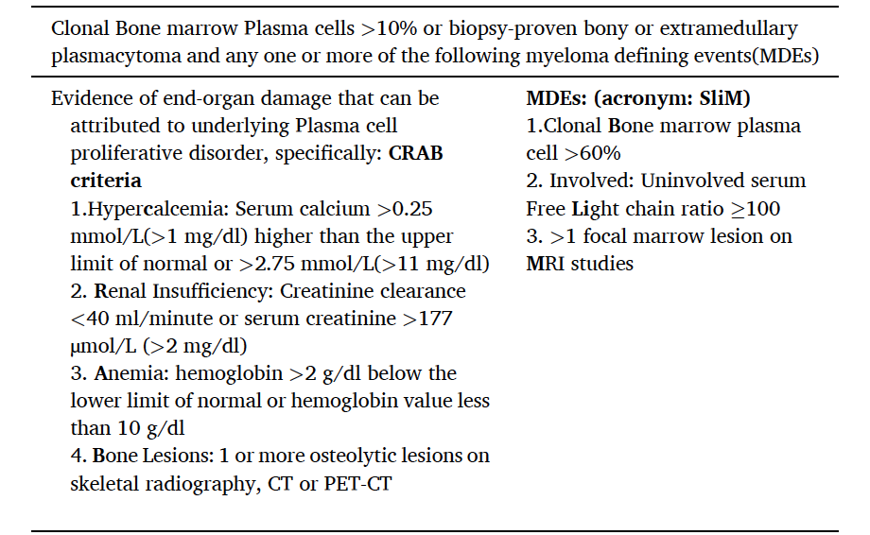

Diagnostic criteria for multiple myeloma
Ravi et al. Cancer Treat Res Commun 2021

Slide 9
Multiple myeloma, a lambda light chain isotype, stage III , mild renal insufficiency
Chemotherapy according to (VTD) regimen:
Bortezomib (Velcade)
Thalidomide
Dexamethasone
2 weeks
Mild right-sided hemiparesis (MRC grade 4), gradually impaired orientation and memory.
Urgent CT: white matter lesions in both hemisphere and cerebellum.
Magnetic resonance imaging (MRI) with angiography was appointed.
UNPUBLISHED DATA – DO NOT COPY OR DISTRIBUTE

Slide 10
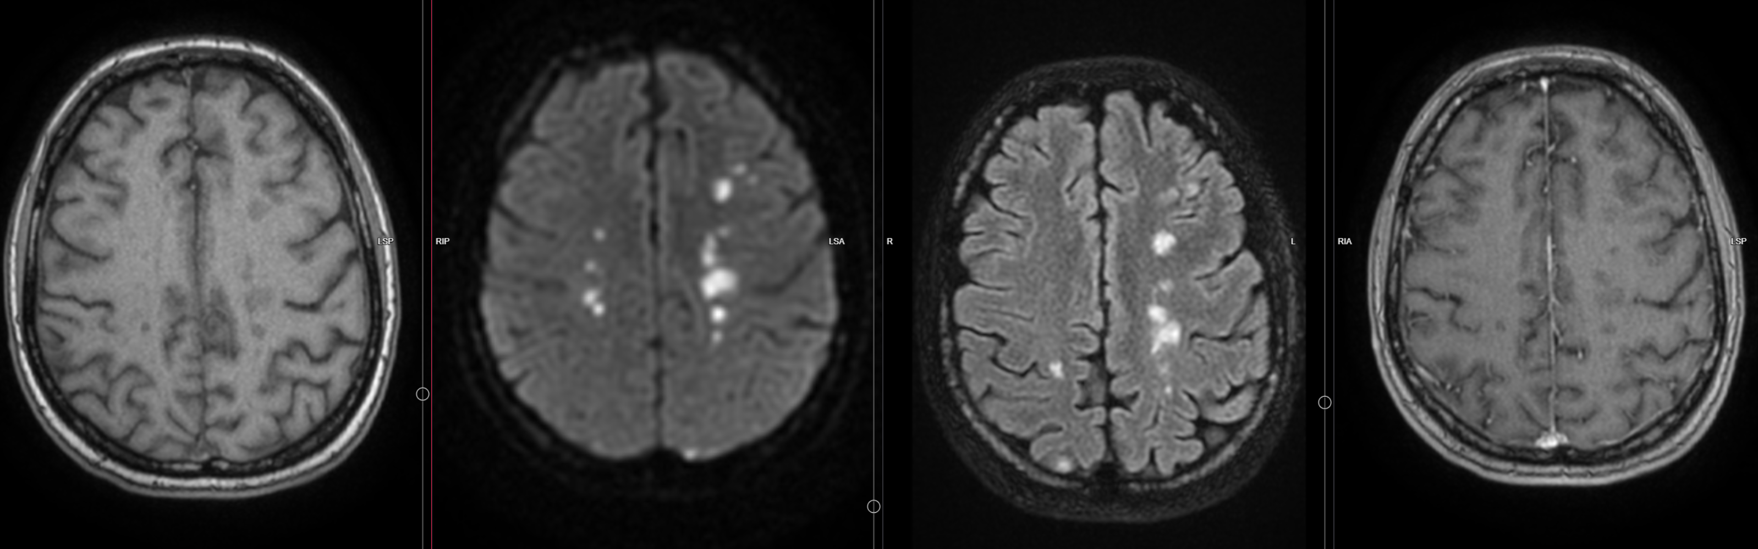
Brain MRI (2018)
A
B
C
D
DWI
T1 DWI FLAIR T1 fs+C
Diffusion
DWI
Multiple brain infarctions, involving bilateral cortical, subcortical, watershed regions and cerebellar hemispheres.
UNPUBLISHED DATA – DO NOT COPY OR DISTRIBUTE

Slide 11
Multimodal Imaging of cerebral arteries
Conventional Angiography – “Gold Standard”
Computed Tomography Angiography (CTA)
Magnetic Resonance Angiography (MRA)
Transcranial color-coded duplex sonography (TCCS)
Valaikiene J, et al. AJNR Am J Neuroradiol 2008

Slide 12
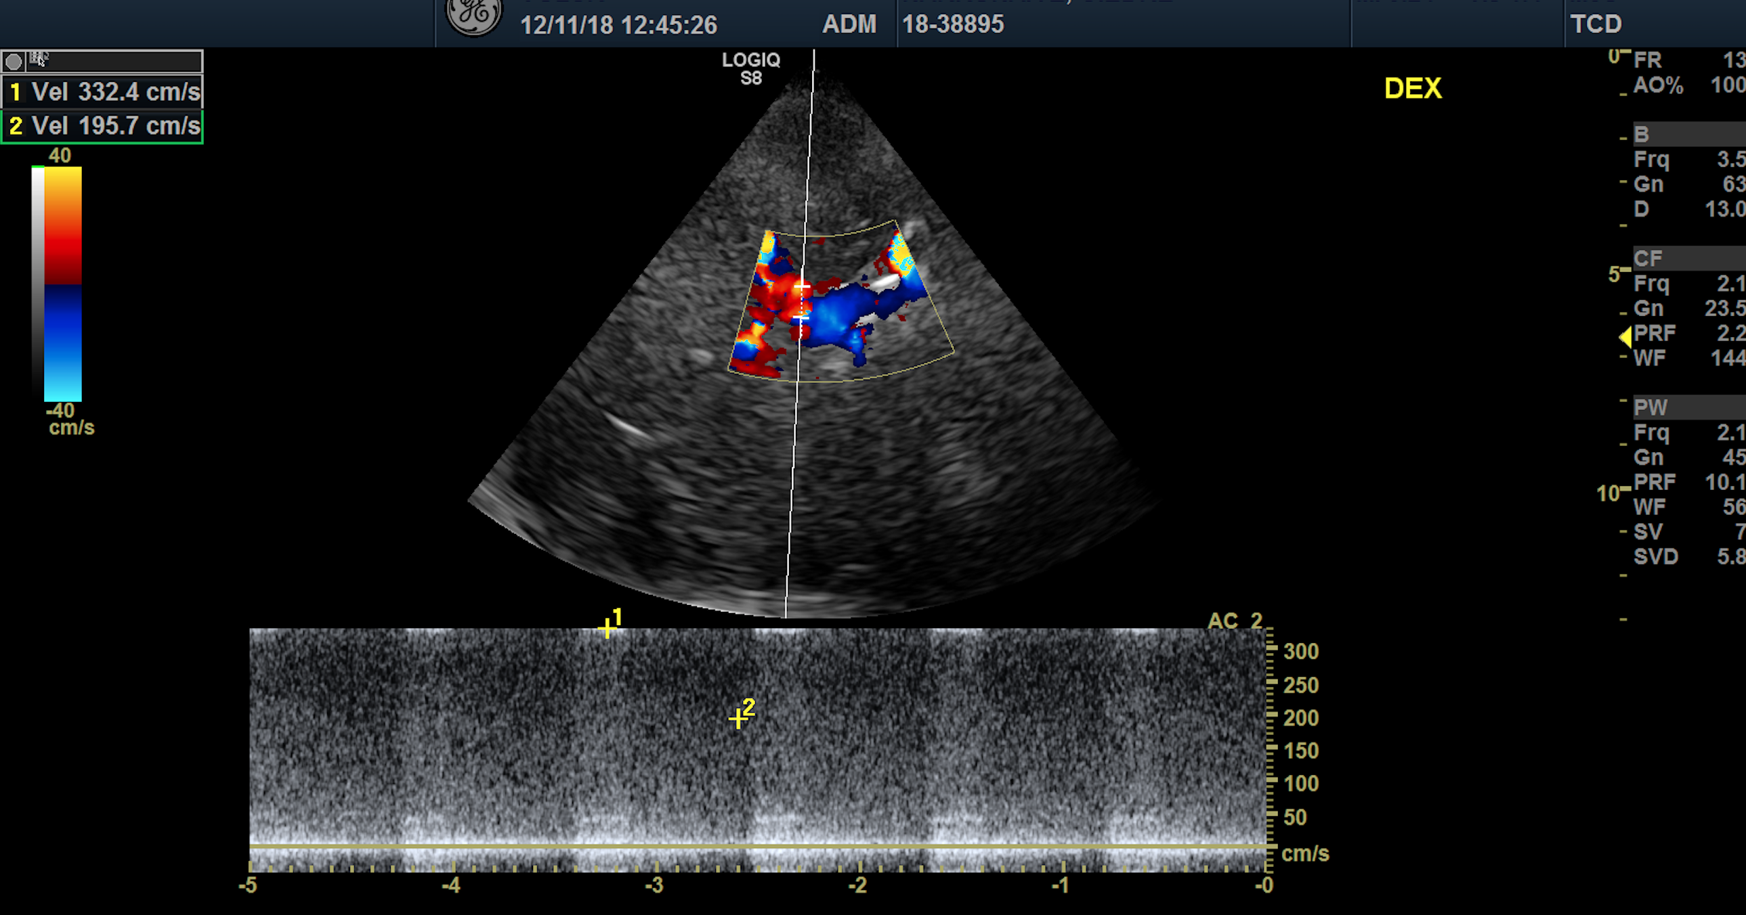
Transcranial color-coded sonography, TCCS (2018)
M1
M1
C4-5
C1
C1
A1
TCCS, coronal scanning plane: left C1-2 segment of ICA
TCCS, coronal scanning plane: right C1-2 segment of ICA
Stenosis >70 % in C1-2 segments of ICA bilaterally.
UNPUBLISHED DATA – DO NOT COPY OR DISTRIBUTE

Slide 13
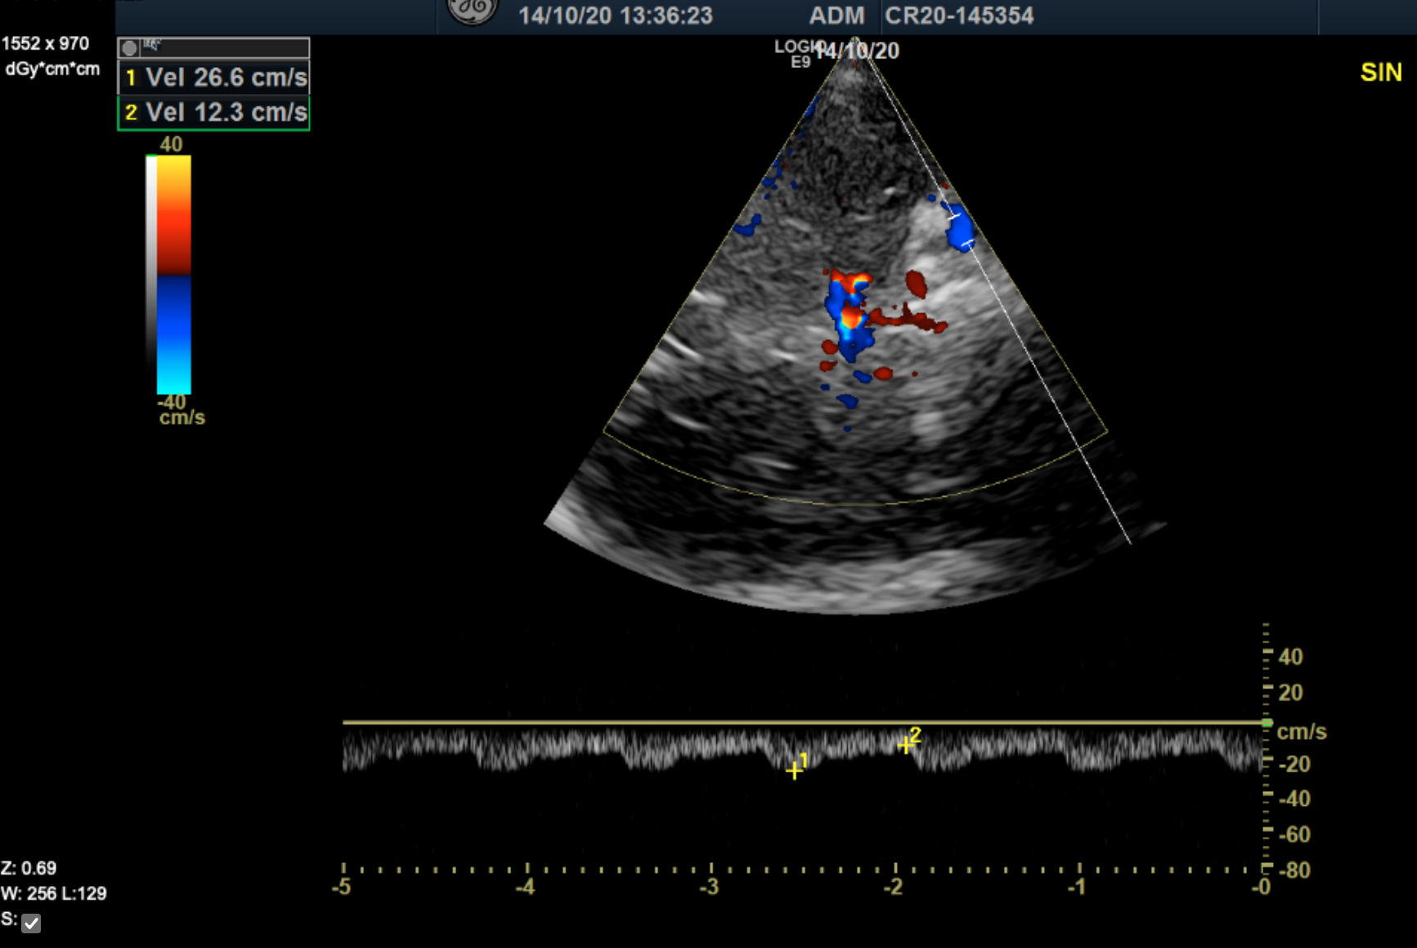
TCCS criteria for intracranial ICA stenosis
M1
C1
M1
C1
C4-5
A1
A1
UNPUBLISHED DATA – DO NOT COPY OR DISTRIBUTE
Post-stenotic M1 flow
C1 stenosis: 307/164 cm/s, C1/ICA=4.0
Pre-stenotic C4-5 flow
Criteria for ≥70% C1 stenosis of intracranial ICA:
PSV >200 cm/s (specificity 100%; sensitivity 71%)
C1/ICA* >3 (specificity 93%; sensitivity 86%)
*the ratio of mean velocies
Valaikiene J, et al. AJNR Am J Neuroradiol 2008

Slide 14
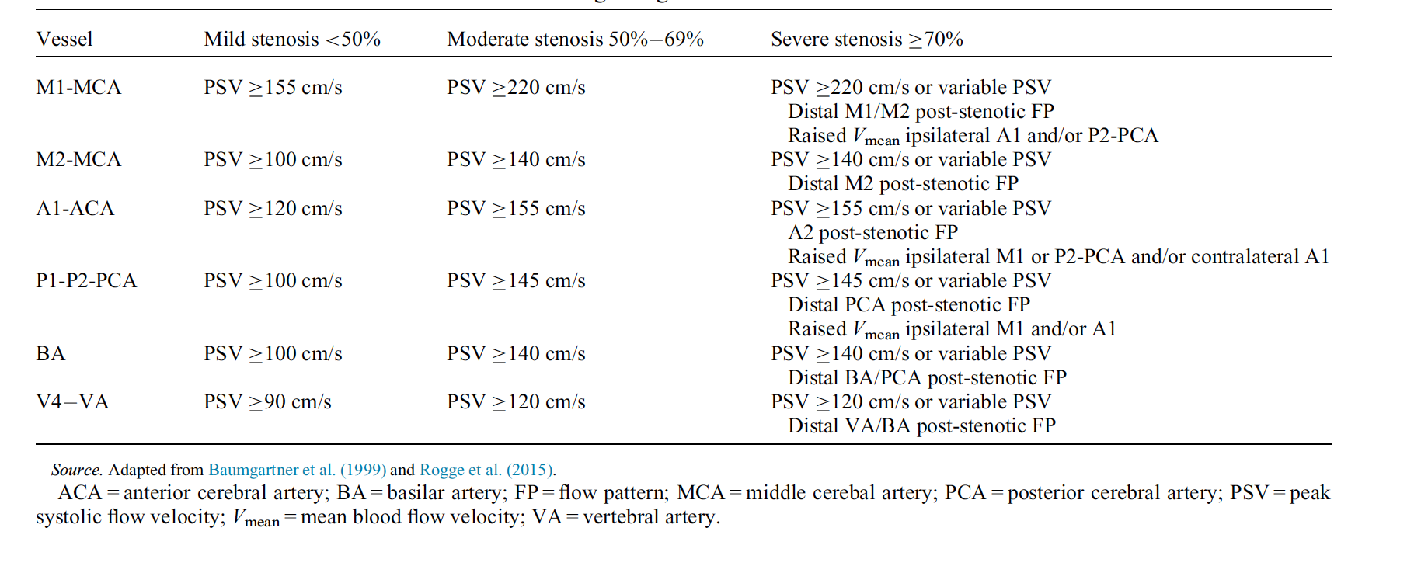
TCCS: grading criteria for intracranial stenosis
Danyel et al. Ultrasound Med Biol. 2020

Slide 15
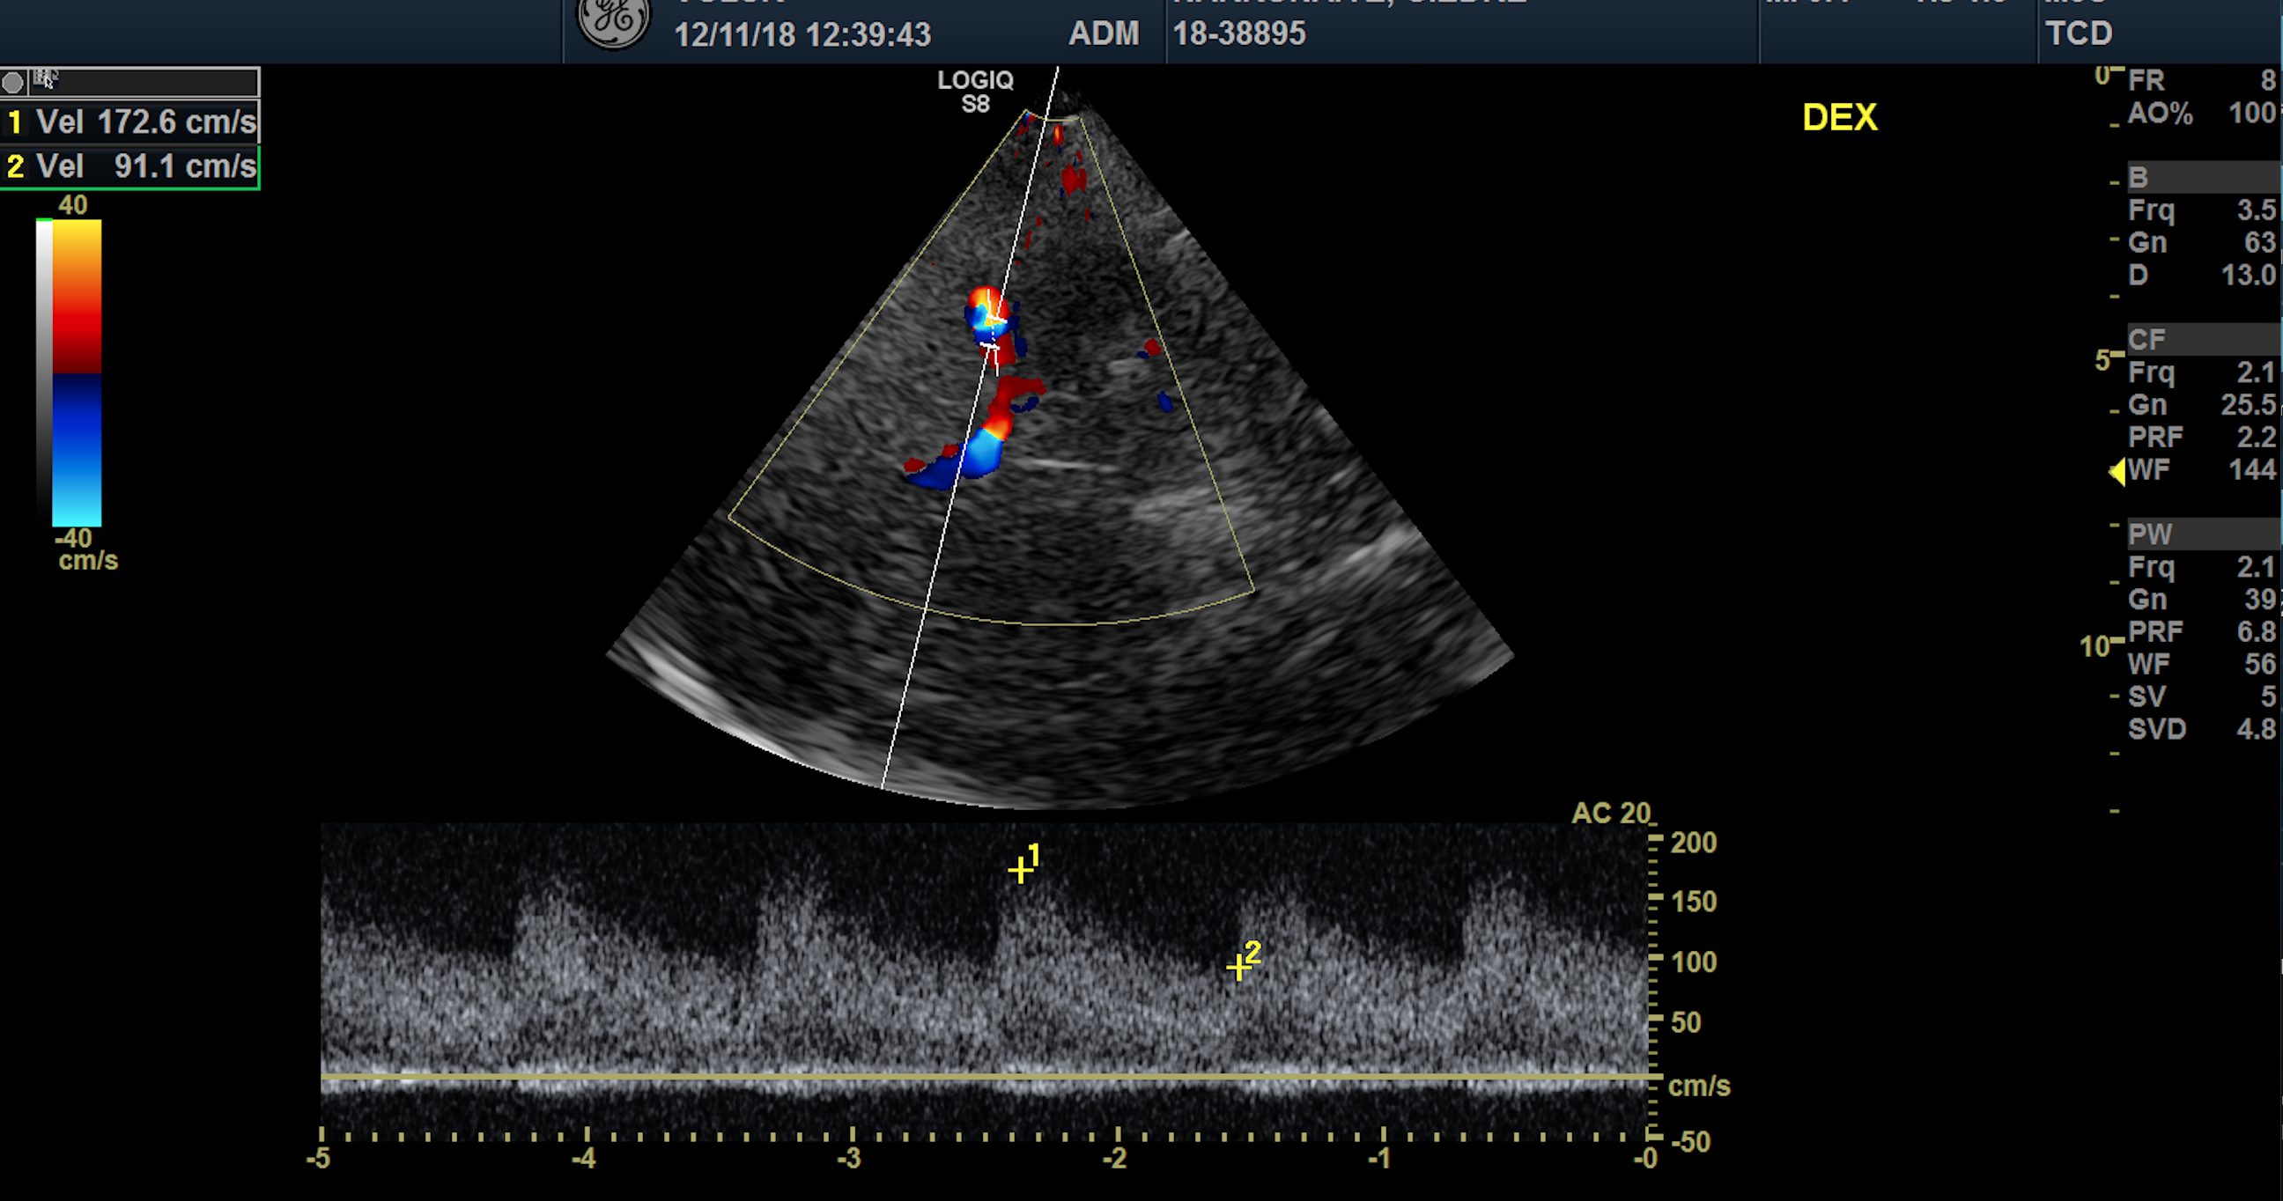
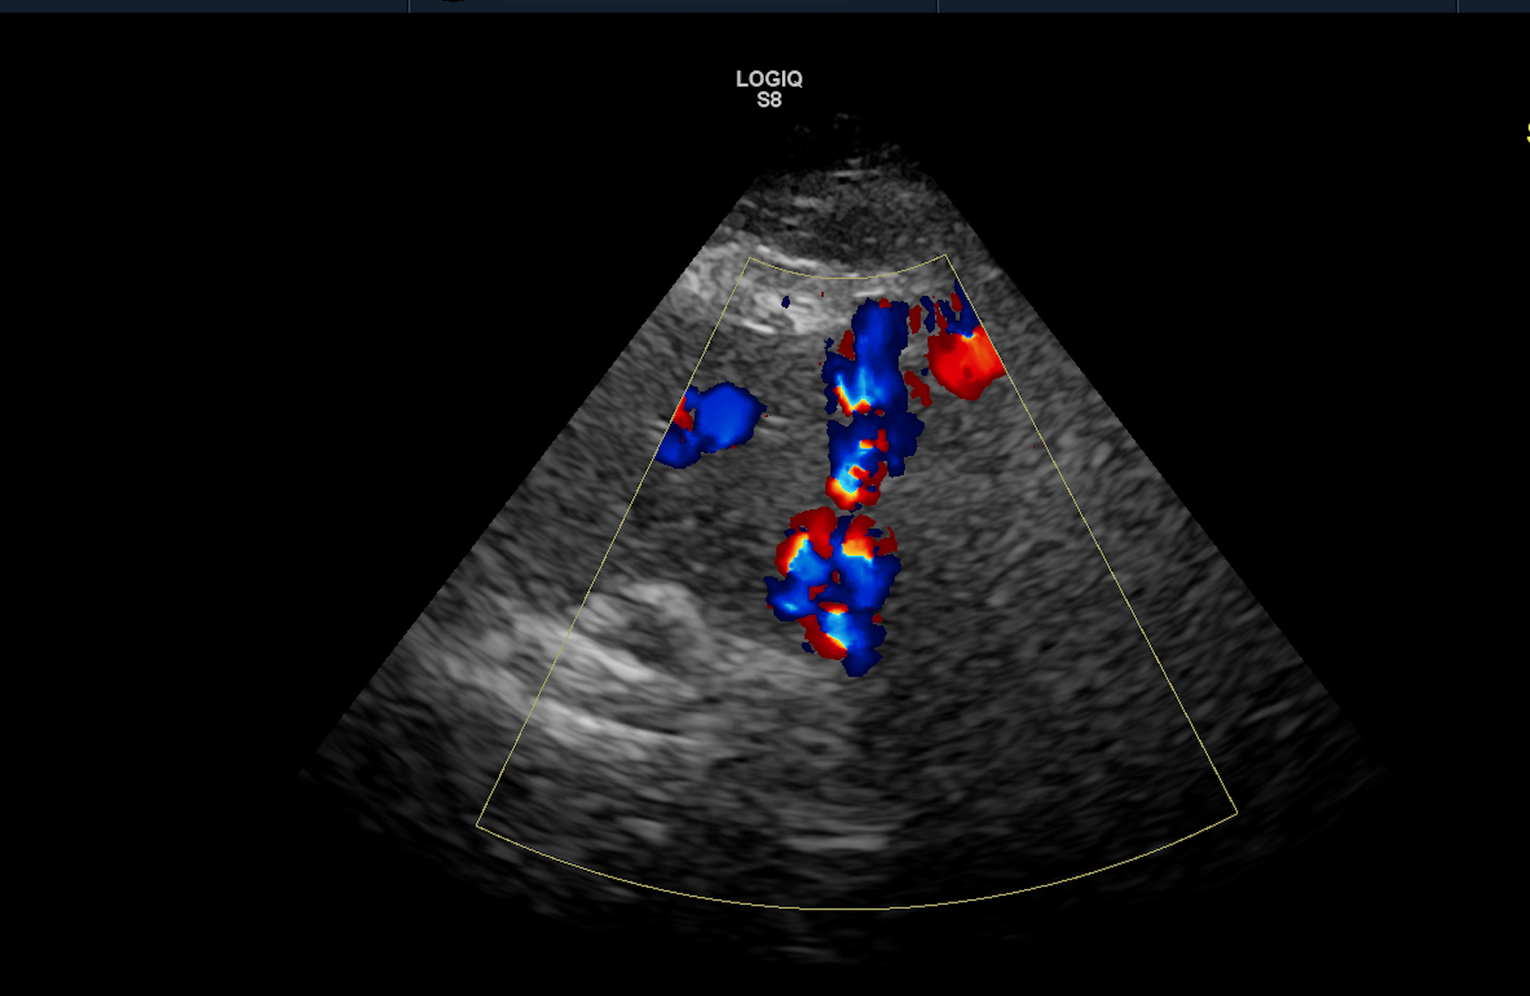
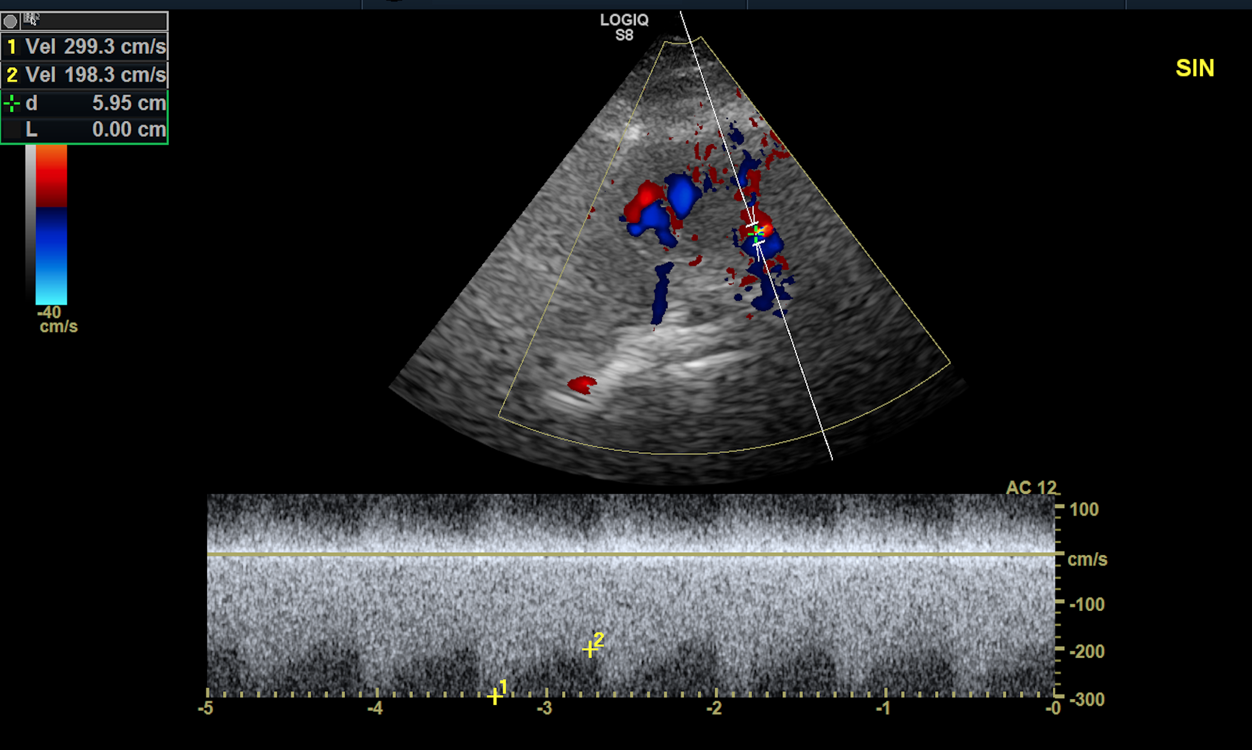
TCCS: right M1, right V4 stenosis, left V4 occlusion in susp.
Right V4
Left V4
Right V4
Right M1 segment stenosis < 50%
Transforaminal approach
Right V4 segment stenosis > 50%
UNPUBLISHED DATA – DO NOT COPY OR DISTRIBUTE

Slide 16
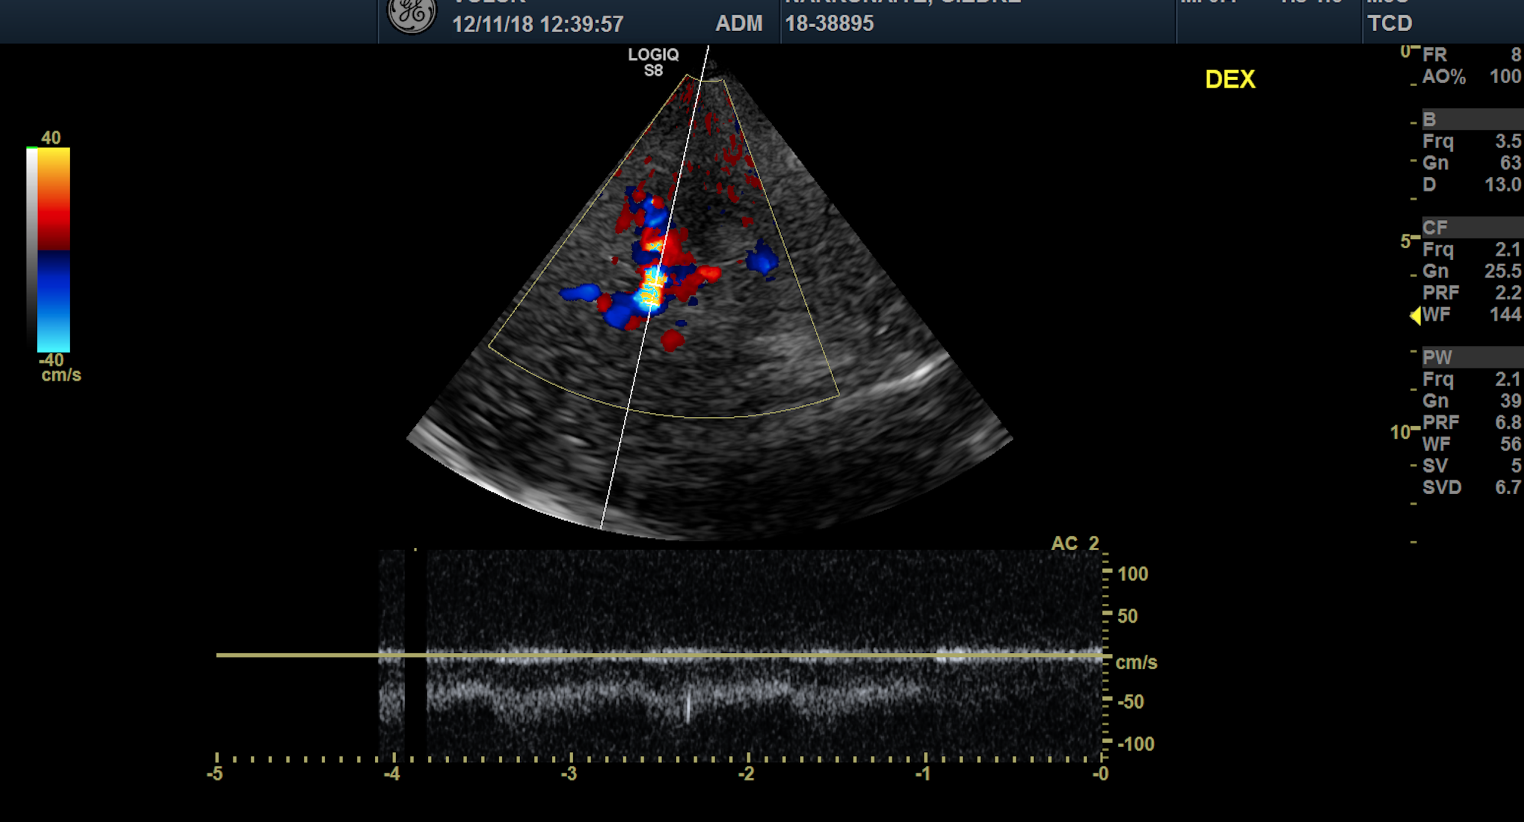
TCCS: microembolic signals, MES (2018)
M1
A1
P1
Transtemporal approach, axial scanning plan: MES registered in right A1 of ACA.
UNPUBLISHED DATA – DO NOT COPY OR DISTRIBUTE

Slide 17
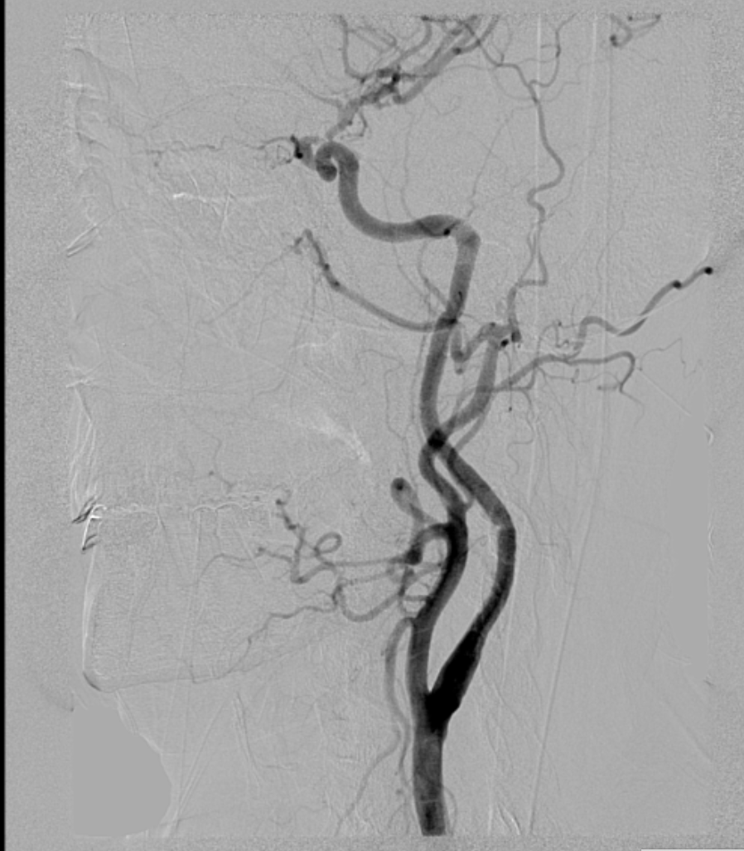
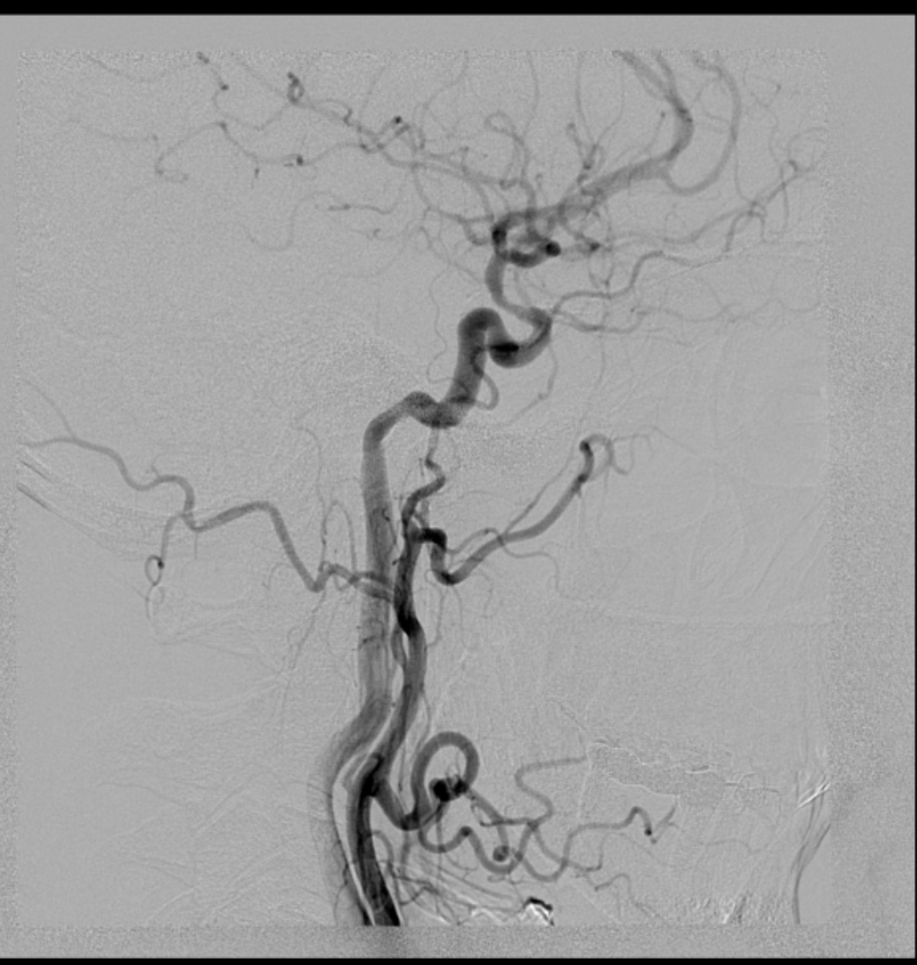
Conventional angiography (2018)
Left ICA
Right ICA
Multiple intracranial lesions: left C1 of ICA stenosis 90% , right ICA C2 60%, right V4 50%, left V4 occlusion.
UNPUBLISHED DATA – DO NOT COPY OR DISTRIBUTE

Slide 18
Further treatment and course of the disease
Thalidomide was discontinued, CyBorD* regimen was activated (5x). Additionally the patient was treated with low-molecular-weight heparin (Nadroparinum calcicum) 0,6x2 for the presumable embolization.
After 3 months the weakness of left hand occurred, aspirin was added. As neurological symptoms progressed, MRI were small new ischemic lesions, VD-PACE** regimen was administered (3x). The remission of MM was achieved at 05. 2019.
To prolong survival, an autologous bone marrow stem cell transplantation was successfully performed at 07. 2019.
*Cyclophosphamide-Bortezomib (Velcade)-Dexamethasone
** Bortezomib-Dexamethasone-Cisplatin (Platinol)-Doxorubicin (Adriamycin)-Cyclophosphamide-Etoposide
UNPUBLISHED DATA – DO NOT COPY OR DISTRIBUTE

Slide 19
The follow-up: TCCS, MRI, genetic testing
Repeated TCCS: intracranial stenotic lesions, predominantly in the distal ICA.
High-resolution MRA: contrast enhancement in the walls of the distal ICA.
Genetic testing of COL4A1, 2, CTC1, GLA, HTRA1, N3ECD, NEMO, NOTCH3, TREX1 – no pathogenic minor/points variant identified in these genes.
No more cerebrovascular events occurred within next two years of the follow-up.
UNPUBLISHED DATA – DO NOT COPY OR DISTRIBUTE

Slide 20
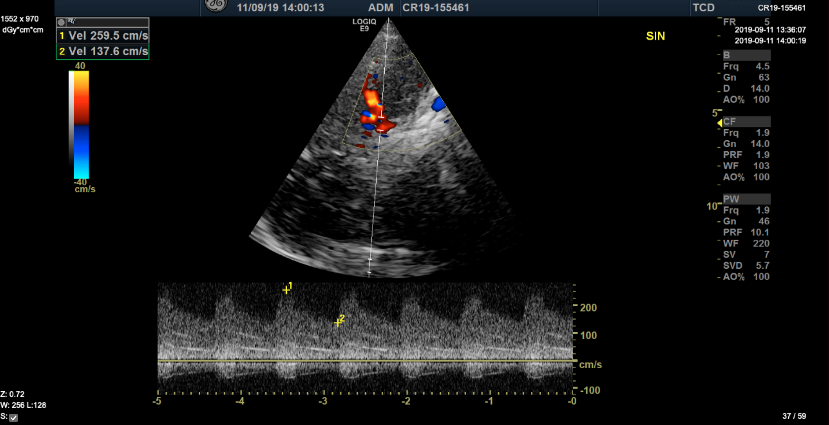
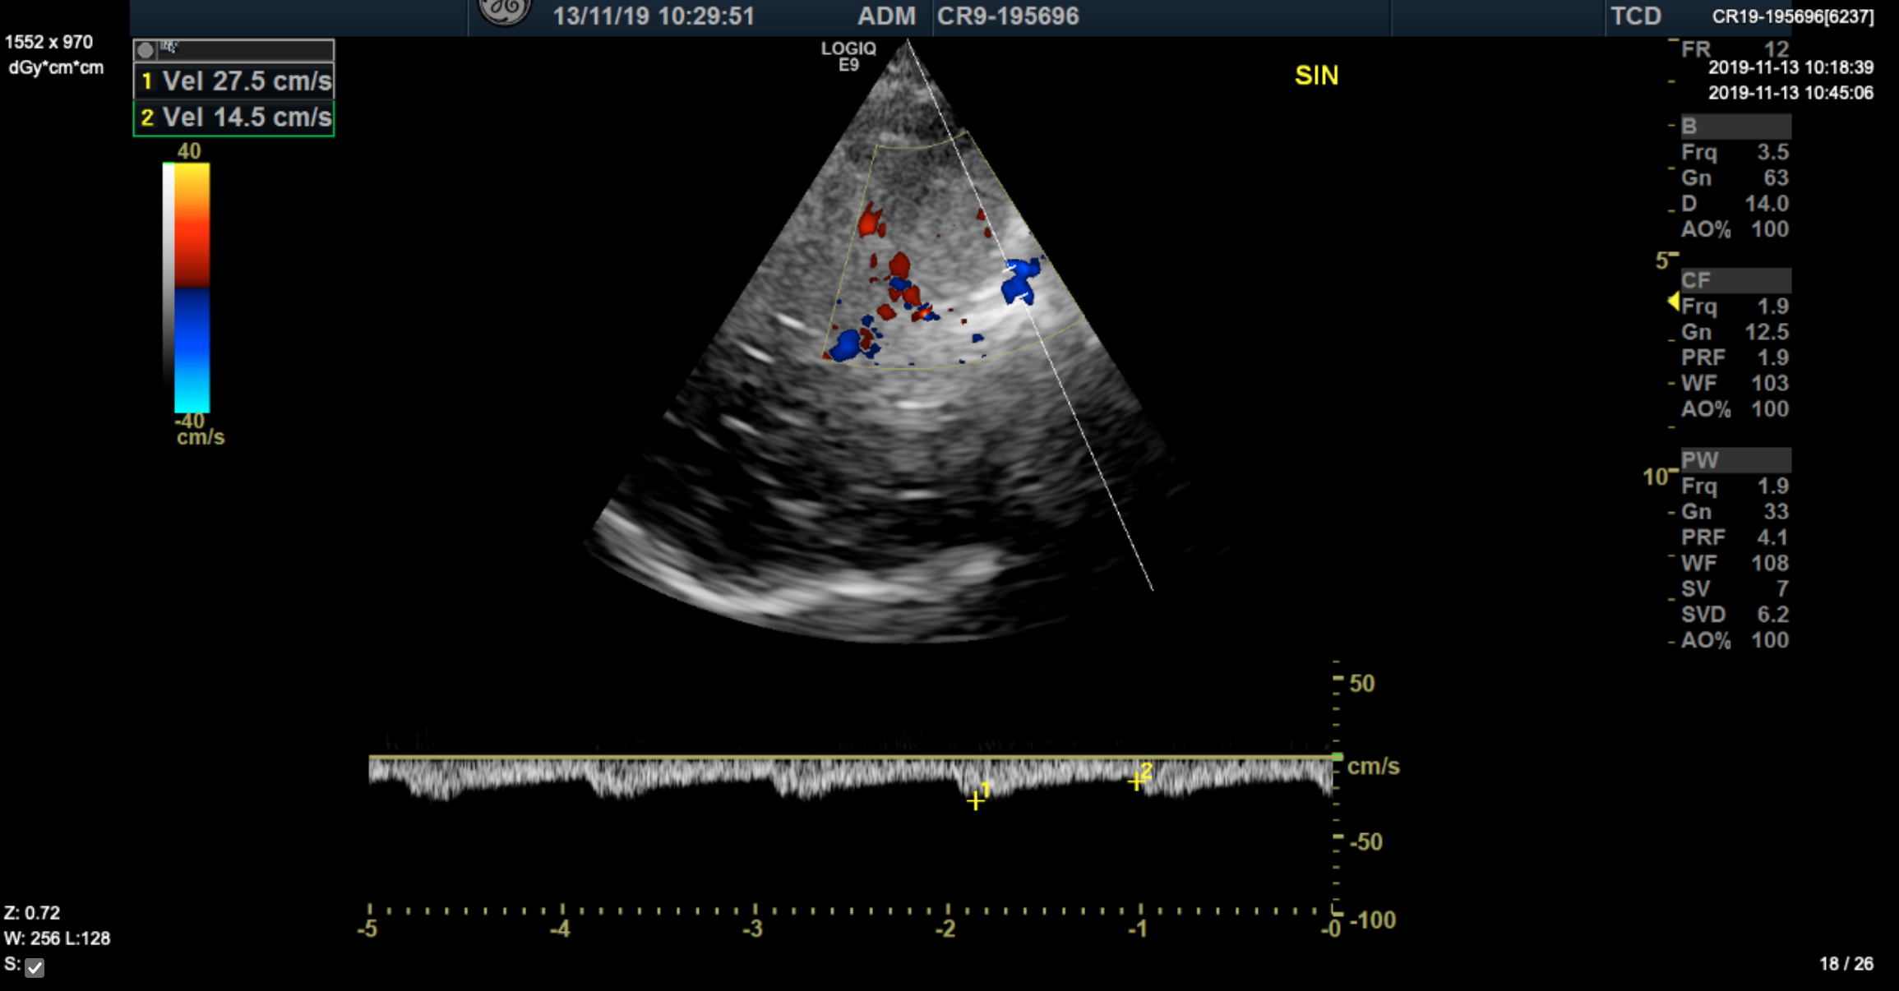
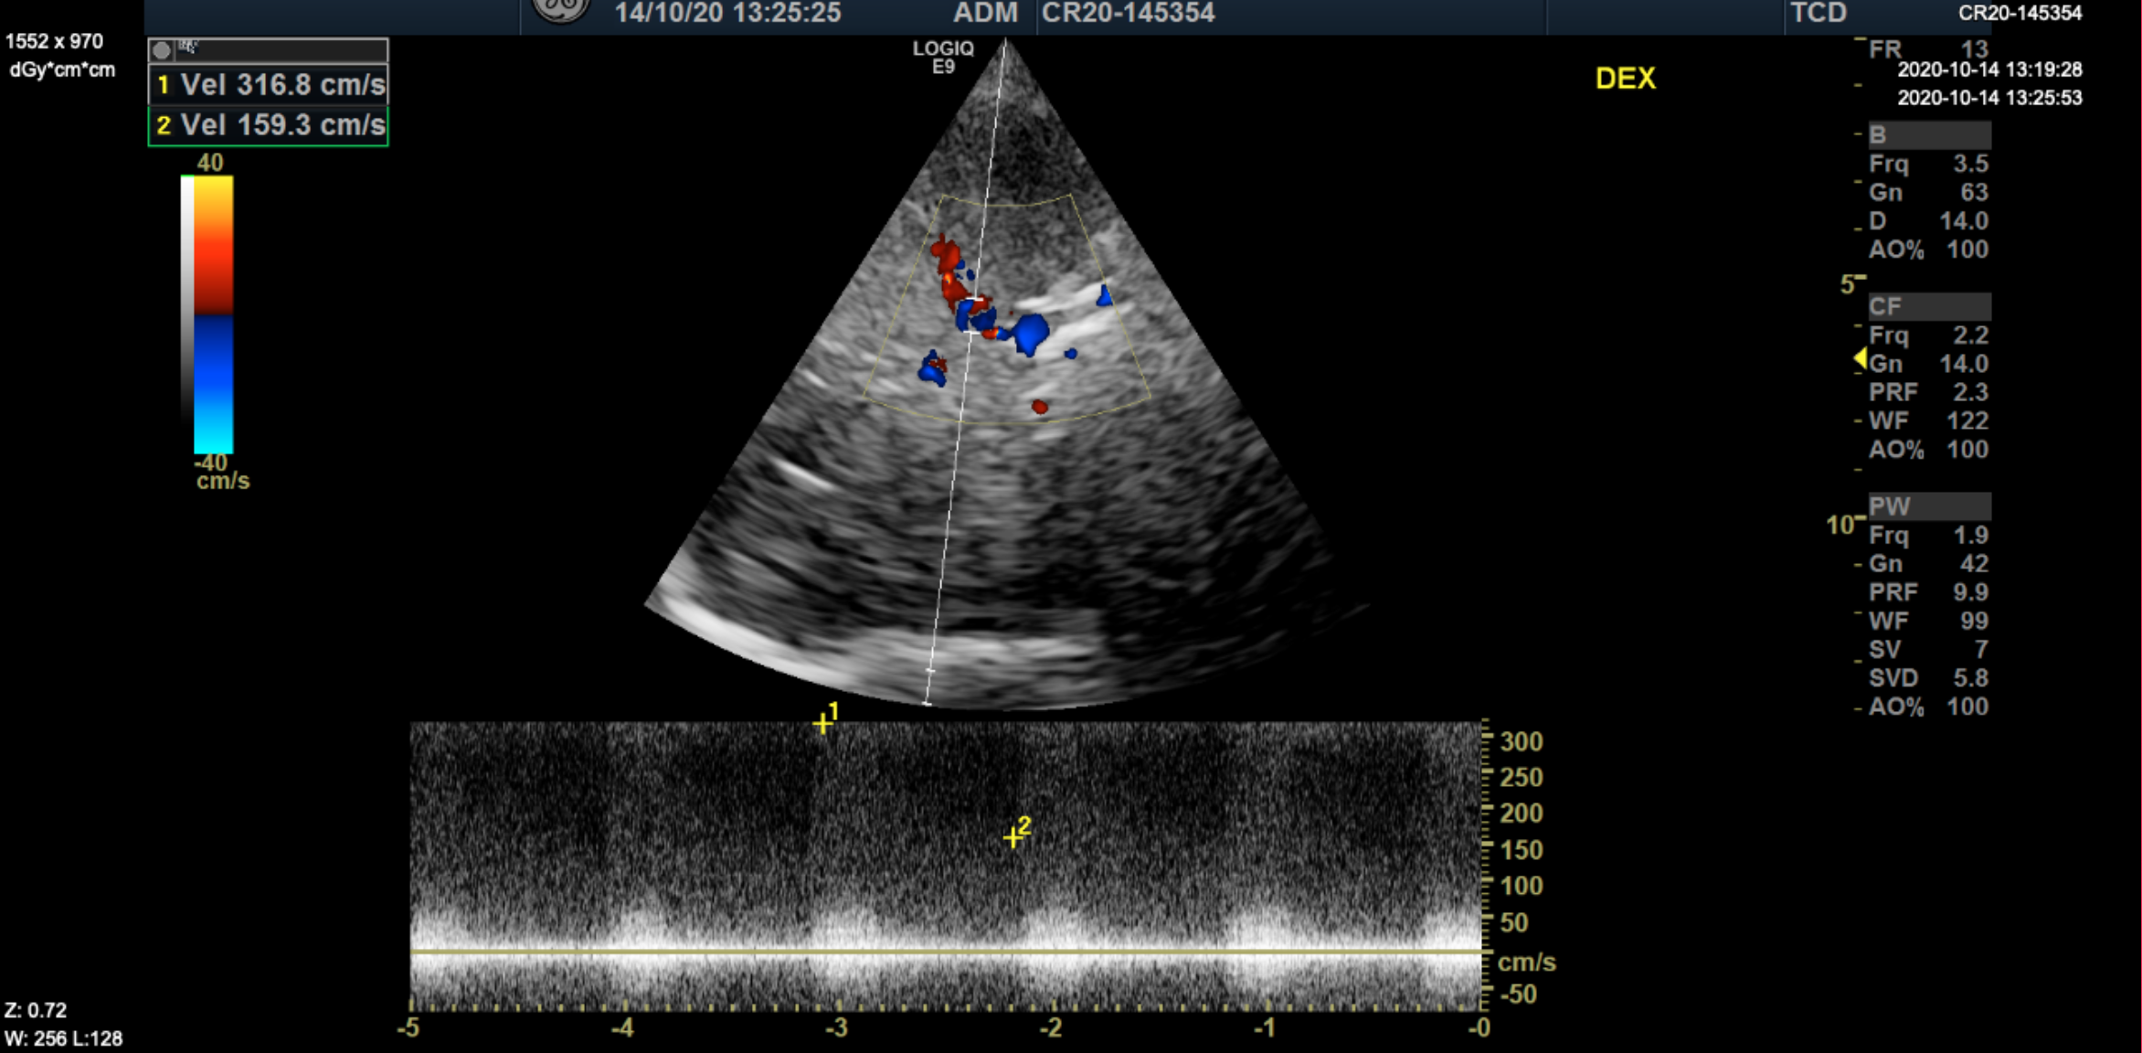
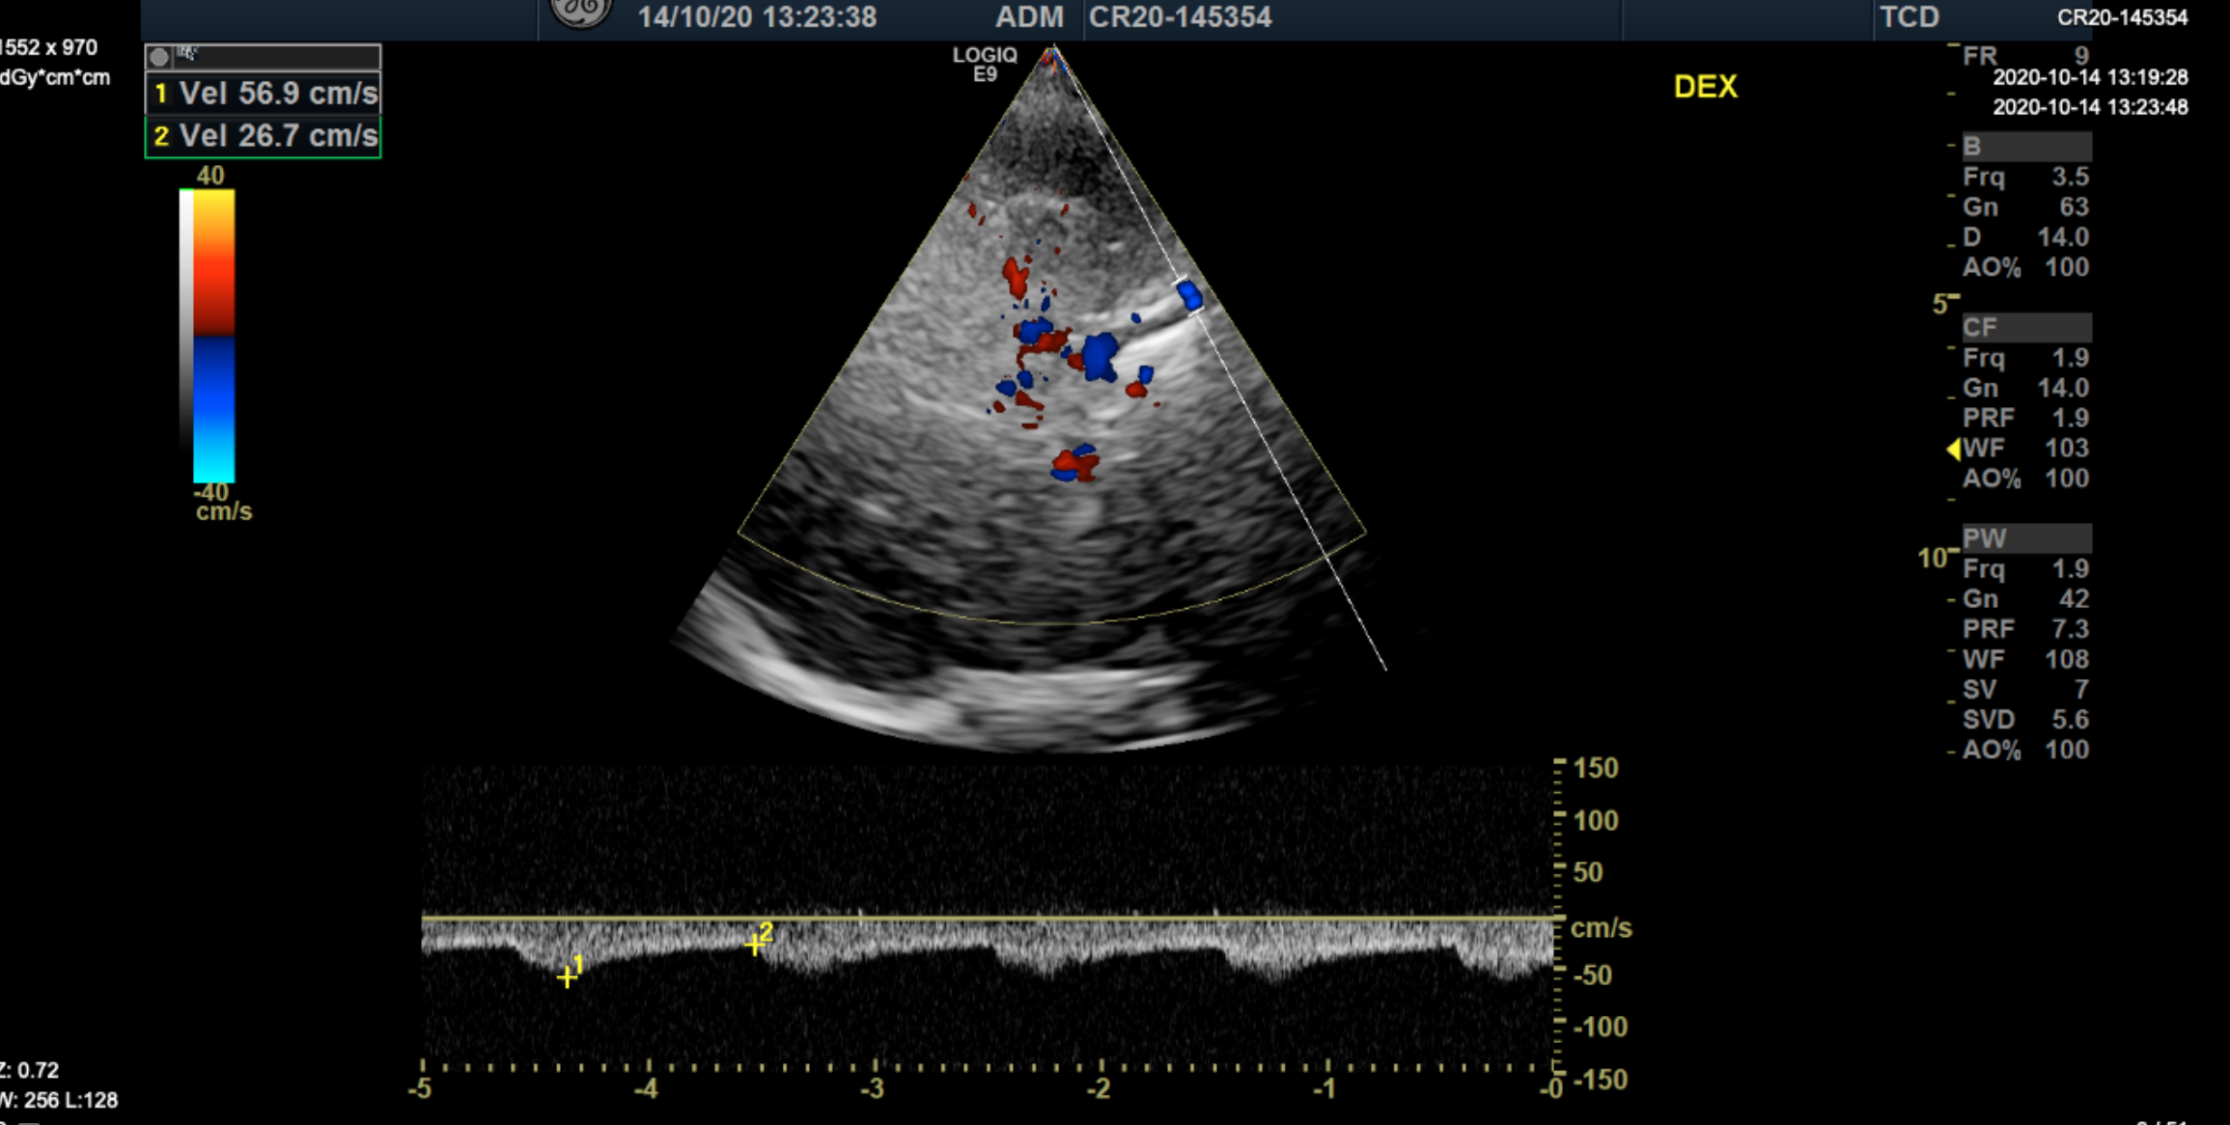
TCCS: bilateral high-grade stenosis of intracranial ICA
M1
C1
C4-5
M1
C4-5
C1
UNPUBLISHED DATA – DO NOT COPY OR DISTRIBUTE

Slide 21
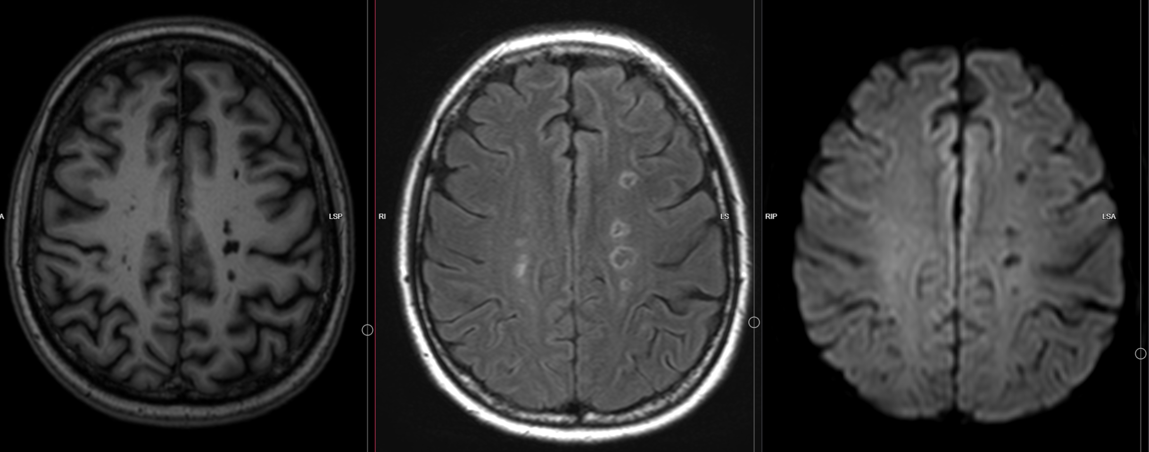
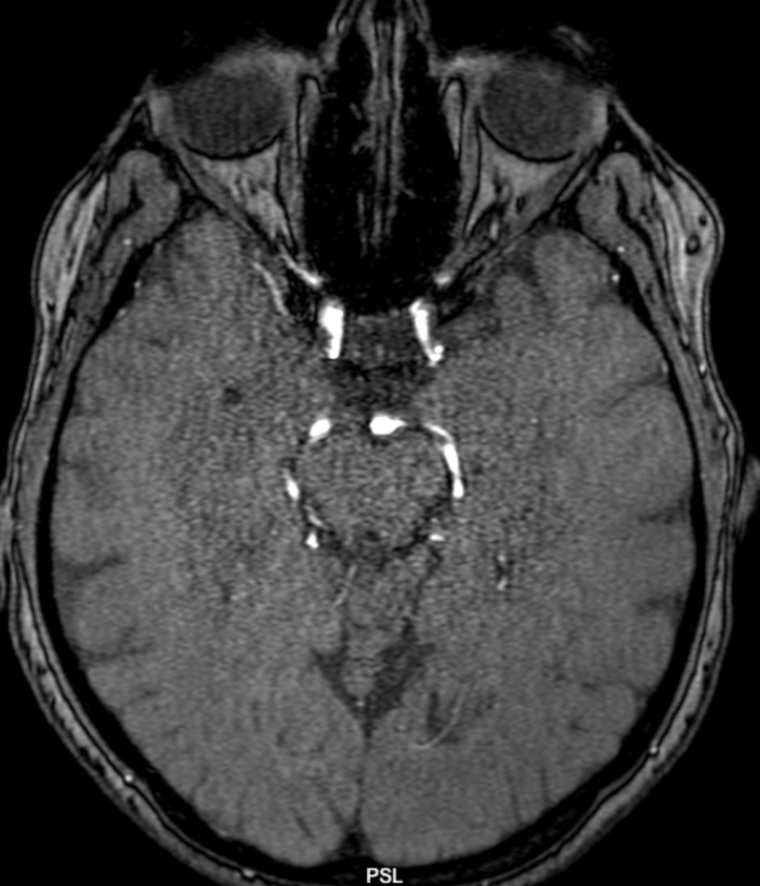
Brain MRI/MRA (2020)
A
C
D
B
D
T1
FLAIR
DWI
T1fs+C
Multiple old ischemic lesions bilateral cortical, subcortical, watershed regions (A-C), contrast enhancement in the walls of the distal ICA (D).
UNPUBLISHED DATA – DO NOT COPY OR DISTRIBUTE

Slide 22
Monoclonal immunoglobulin deposition disease, MIDD
Characterized by the deposition of monoclonal light and/or heavy chains within glomerular, tubular and vessel wall basement membranes.
Systemic disorder, with predominant renal manifestations, other organs can be involved.
Roughly half of patients diagnosed with MIDD will have myeloma.
The most common form of MIDD is LC DD, where either kappa or lambda LC are deposited in tubular, glomerular and vessel wall basement membranes.
Recently, a mouse model of LCDD provided further insights into the mechanisms of LCDD.
Cohen et al. Diagnostics (Basel) 2021; Herlitz, Calle, in Onco-Nephrology 2020; Bender et al. Blood 2020

Slide 23
Conclusions
Lambda light chain MM may present with multiple cerebral infarctions and vasculopathy of non-atherosclerotic origin.
TCCS is a reliable method for initial diagnostic and for follow-up of stenotic lesions of intracranial ICA.
UNPUBLISHED DATA – DO NOT COPY OR DISTRIBUTE

Slide 24
Thank you for your attention!
jurgita.valaikiene@santa.lt

